Slide 1


Department of Information Technology
Velagapudi Ramakrishna Siddhartha Engineering College
REPORT GENERATION ON CHEST X-RAYS USING DEEP LEARNING
COMPUTER VISION AND REMOTE SENSING
B.Tech in Information Technology
Epics Project Review Presentation
Presented by
Jaya Naga Venkata Sai Motamarri (208W1A12A0)
Monica Panitini (208W1A12A5)
Saiesh Vemulapalli (208W1A12C7)
Under the guidance of
Dr. M.Ashok kumar , Assistant professor

Slide 2
AGENDA
Problem statement
Abstract
Objectives and outcomes
Literature review
Requirements
Architecture diagram
Algorithms
Implementation steps
Result analysis
Conclusion
Future scope

Slide 3
PROBLEM STATEMENT
The aim is to generate a medical report by chest x-rays using deep learning.It is often time-consuming and tedious to get detailed medical reports from these x-rays. In high population countries, a radiologist may come across 100s of x-ray images. So if a properly learned deep learning model can automatically generate these medical reports, considerable work and time can be saved.

Slide 4
ABSTRACT
The chest x-ray is the most commonly performed diagnostic x-ray examination. A chest xray produces images of the heart, lungs, airways, blood vessels, and the bones of the spine and chest. Often time, it is the duty of a radiologist to conclude these x-rays so that to give appropriate treatment to the patients. It is often time-consuming and tedious to get detailed medical reports from these x-rays. In high population countries, a radiologist may come across 100s of x-ray images.In this project an Encoder and decoder with attention model is used to generate the text report and pretrained CheXnet model is used to obtain the image features.

Slide 5
Objectives & Outcomes
Objectives:
This project aims to present a compilation of the most outstanding deep learning strategies focused on the automatic generation of medical reports from X-Ray images.
In order to handle this challenging problem, deep learning algorithms have been include with models, to get promising results.
Outcome:
The medical report generated from the model in the final stage.

Slide 6
LITERATURE REVIEW
S.NO | TITLE | PUBLICATION YEAR | SUMMARY | Results
1 | Attention based automated radiology report generation using CNN and LSTM | 2022 | In this paper, to address this issue an approach is proposed,based on the continuous integration of convolutional neural networks and long short-term memory for detecting diseases, followed by the attention mechanism for sequence generation based on these diseases | Various images were tested using three methods, that is, VGG + LSTM, VGG + GRU, and VGG + Bi-directional LSTM. The training process is accomplished for the above-mentioned models, and the results are obtained and clearly identified that the VGG + LSTM model is more accurate than the other techniques
2 | Report Generation of Lungs Diseases from Chest X-ray using NLP | 2022 | In their experiments, they described a strategy on the basis of CNN-RNN architecture with attention mechanism. Predicted the results of their model trained on the dataset. | In this the CNN-RNN with attention model is more accurate than the encoder and decoder model.
3

Slide 7
S.NO | TITLE | PUBLICATION YEAR&PAPER TYPE | SUMMARY | Results
3 | An Automated medical report generation | 2020 | In this paper, they build a multi-task learning framework which jointly performs the prediction of tags and the generation of paragraphs, propose a co-attention mechanism to localize regions containing abnormalities and generate narrations for them, develop a hierarchical LSTM model to generate long paragraphs | the models with a single LSTM decoder perform much worse than those with a hierarchical LSTM decoder
4 | Automated radiology report generation using conditioned transformers | 2021 | They proposed a new deep learning that uses visual and semantic features to condition a pre-trained transformer and then add semantic similarity metrics besides word-overlap metrics for the quantitative analysis | Their model was able to generate accurate reports for 61.7%, 28.2% had missing information, and 10.2% had a false diagnosis. .

Slide 8
REQUIREMENTS
Data set(Indiana University - Chest X-Rays(x-rays and xml reports))
X-rays-7471
XML rports-3955
Open Cv
Tensorflow
Python Modules
Google Colab

Slide 9
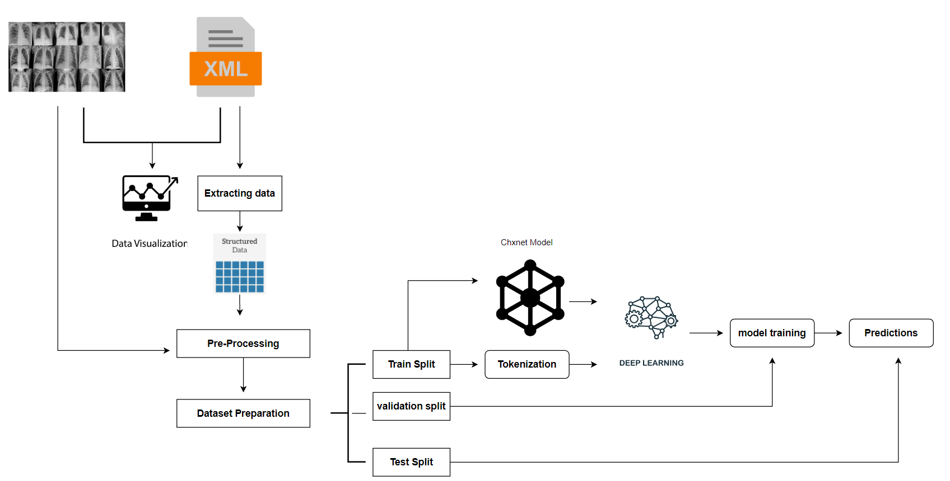
ARCHITECTURE DIAGRAM​

Slide 10
ALGORITHM-LSTM
Step 1: Decide How Much Past Data It Should Remember
The first step in the LSTM is to decide which information should be omitted from the cell in that particular time step. The sigmoid function determines this. It looks at the previous state (ht-1) along with the current input xt and computes the function
Step 2: Decide How Much This Unit Adds to the Current State
In the second layer, there are two parts. One is the sigmoid function, and the other is the tanh function. In the sigmoid function, it decides which values to let through (0 or 1). tanh function gives weightage to the values which are passed, deciding their level of importance (-1 to 1).

Slide 11
Step 3: Decide What Part of the Current Cell State Makes It to the Output
The third step is to decide what the output will be. First, we run a sigmoid layer, which decides what parts of the cell state make it to the output. Then, we put the cell state through tanh to push the values to be between -1 and 1 and multiply it by the output of the sigmoid gate

Slide 12
ALGORITHM-GRU
Now let’s see the functioning of these gates. To find the Hidden state Ht in GRU, it follows a two-step process.
The first step is to generate what is known as the candidate hidden state.
It takes in the input and the hidden state from the previous timestamp t-1 which is multiplied by the reset gate output rt.
Later passed this entire information to the tanh function, the resultant value is the candidate’s hidden state.
Once we have the candidate state, it is used to generate the current hidden state Ht. It is where the Update gate comes into the picture.

Slide 13
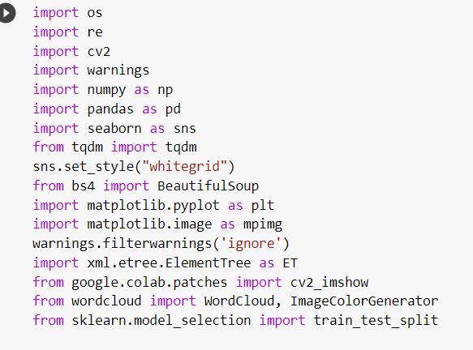
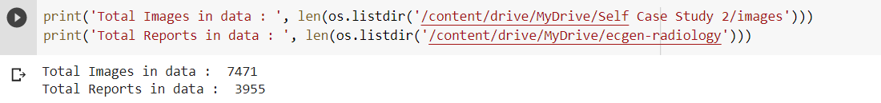
IMPLEMENTAION STEPS
IMPORTING LIBRARIES AND DATASETS (BOTH X-RAYS AND XML REPORTS)

Slide 14
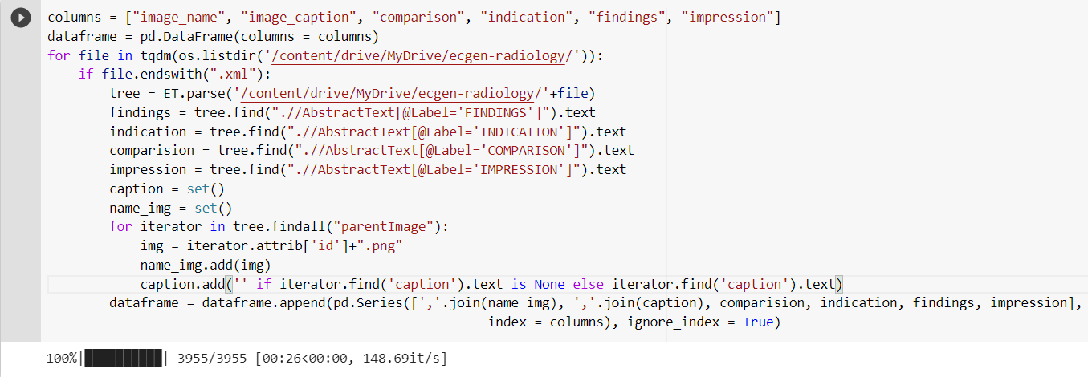
IMPLEMENTAION STEPS
EXTRACTING INFORMATION FROM XML REPORTS

Slide 15
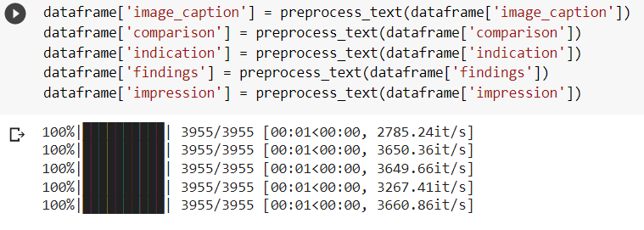
IMPLEMENTAION STEPS
DATA PRE-PROCESSING

Slide 16
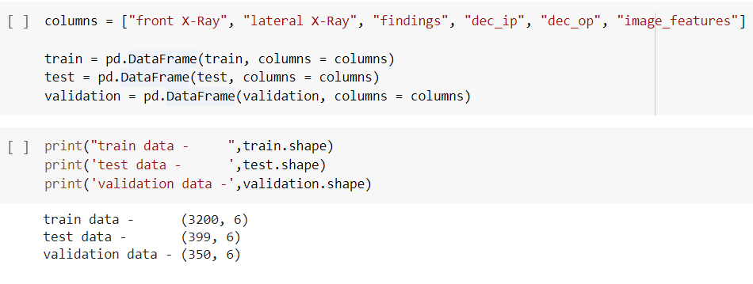
IMPLEMENTAION STEPS
Splitting data(Train data-81%,Validation data-10%,Test data-9%)

Slide 17
IMPLEMENTAION STEPS
TRAIN THE MODEL

Slide 18

IMPLEMENTAION STEPS
EVALUATING THE LOSS

Slide 19
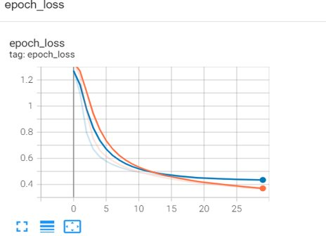
IMPLEMENTAION STEPS
EVALUATING THE LOSS

Slide 20
IMPLEMENTATION STEPS
IMPORTING LIBRARIES AND DATASETS (BOTH X-RAYS AND XML REPORTS)
VISUALIZING THE SAMPLE DATA
STRUCTURED DATA
DATA PREPROCESSING
- TEXT DECONTRACTION
- EXTRACTING THE DATA FROM XML FILES
- REMOVING THE NULL VALUES
- PREPROCESSING THE TEXT FEATURES
DISPLAYING SAMPLE IMAGES WITH TEXT FEATURES
DATASET PREPARATION

Slide 21
IMPLEMENTATION STEPS
SPLITTING THE DATASET
TOKENIZATION
LOAD CHXNET MODEL
ENCODER AND DECODER WITH ATTENTION MODEL
CUSTOM LOSS FUNCTION
MODEL TRAINING
PREDICTIONS ON SAMPLE TEST DATA

Slide 22
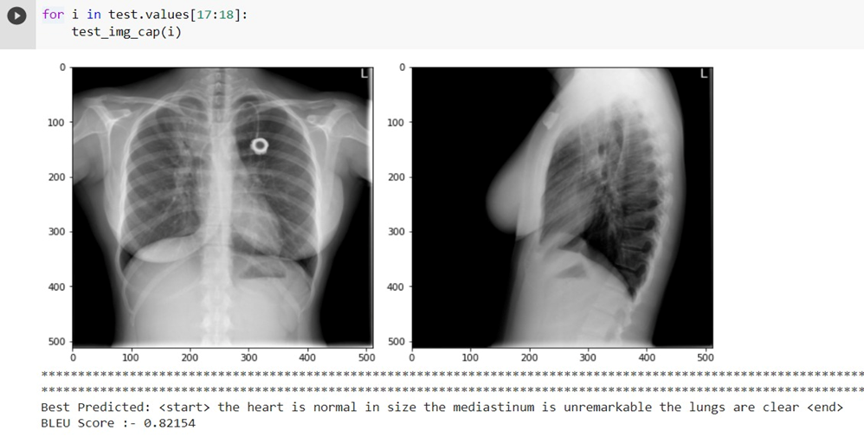
RESULT ANALYSIS
Hence generated a text report for given x-ray images with BLEU score 0.82

Slide 23
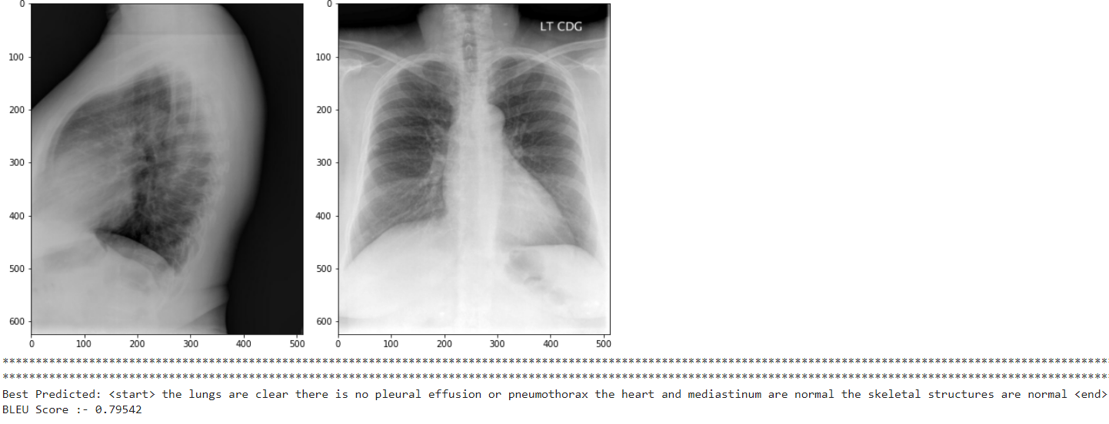
RESULT ANALYSIS
Hence generated a text report for given x-ray images with BLEU score 0.79

Slide 24
CONCLUSION
We just saw an end-to-end deep learning case study of image captioning in the medical field. We understood the problem and the need for such applications. Here we generated a report on chest x-rays and generated report by model is measured by BLEU score. By building an Attention model, The results are promising and the impression statements are meaningful according to the X-ray image.

Slide 25
FUTURE SCOPE
Can decrease the time taken to generate the report
Along with the report generation it can also be used to detect the diseases.

Slide 26
REFERENCES
https://journals.plos.org/plosone/article?id=10.1371/journal.pone.0262209
https://www.researchgate.net/publication/359348795_Report_Generation_of_Lungs_Diseases_from_Chest_X-ray_using_NLP
https://paperswithcode.com/task/medical-report-generation
https://www.sciencedirect.com/science/article/pii/S2352914821000472
https://www.kaggle.com/datasets/raddar/chest-xrays-indiana-university

Slide 27
Thank You

